Slide 1
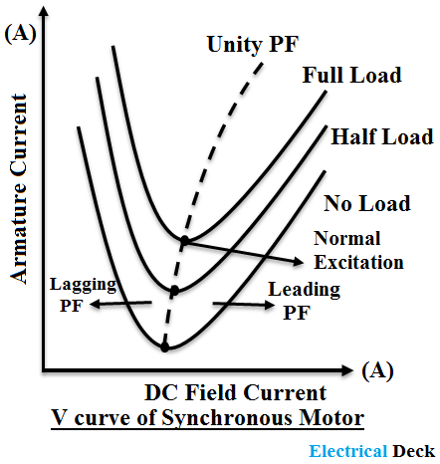
V- curve

Slide 2
V- curve:
V curve is a plot of the stator current versus field current for different constant loads.
The Graph plotted between the armature current Ia and field current If at no load the curve is obtained known as V Curve.
Since the shape of these curves is similar to the letter “V”, thus they are called the V curve of a synchronous motor.

Slide 3
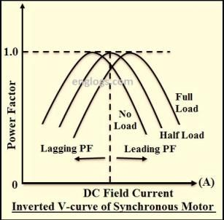
Inverted V curve

Slide 4
Inverted V curve
Inverted V curves of a synchronous motor are defined as the graphs plotted between power factor (cosø) and field current (If) of the motor.
The inverted V-Curves of synchronous motor shows how the power factor varies with excitation.
From inverted V-curves, it is observed that the power factor is lagging when the motor is under excited
and leading when it is over-excited.
In between, normal/critical excitation the power factor is unity.

Slide 5
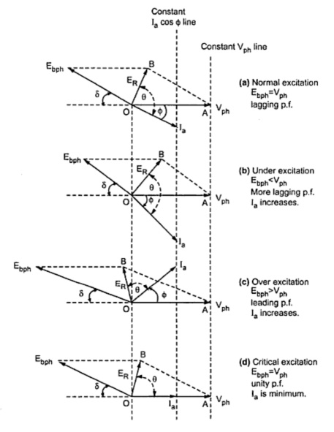
Effect of change in excitation:The change in DC excitation of a synchronous motor will also change the power factor.

Slide 6
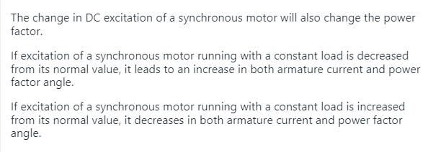
Effect of change in excitation:

Slide 7
